Slide 1

How to link a test to a launcher (in this case a shell launcher)
How to scan existing tests
How to create multiple configurations
Include tests into a campaign
See a sample of shell script (bash .sh)

Slide 2
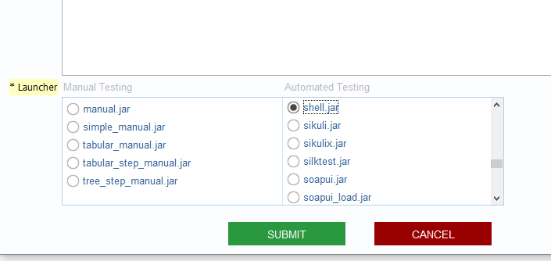
To use shell scripts you need to cerate a Category that references the shell.jar launcher
XStudio
DB
Testxxx
Testxxx will be in Category “shell test script”
that uses the shell.jar launcher

Slide 3
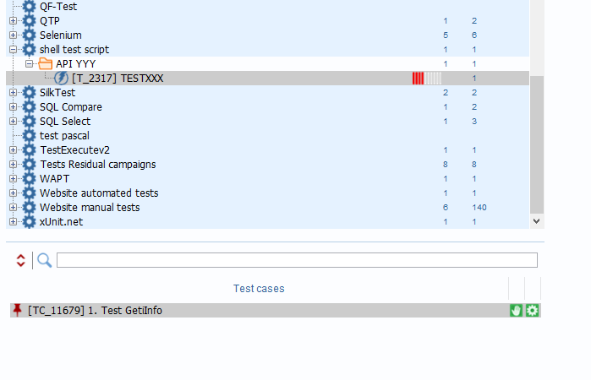
Then you create a test and its test case(s) in a folder
XStudio
DB
Testxxx
Here, we created
The Category
A folder “API YYY” to manage a subset of our test
The TESTXXX
And finally an empty Test Case

Slide 4
Alternatively you can scan all of your existing tests
and load them into your category
saving you the time to re-enter them all (useful when you already get many…)
XStudio
DB
Testxxx
Right click on the category, choose “scan/search local …”
It will request you for a configuration

Slide 5
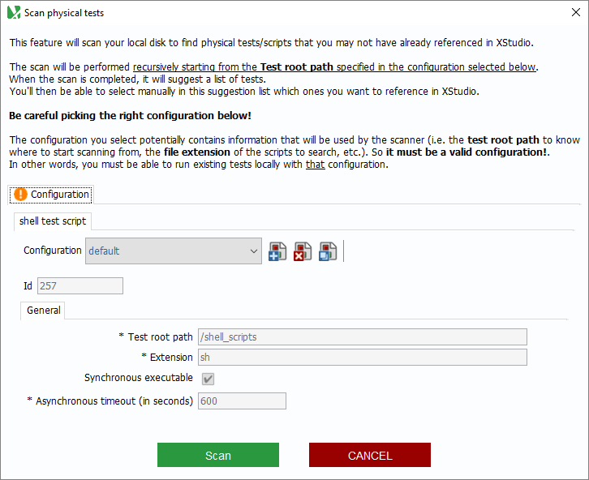
Indicate where your test files are located on your server/PC
Here, it is in ‘/schell_Scripts’
Indicate the extension of your shell scripts
Here, it is ‘.sh’
Indicate if your want to run your script in synchronous mode (launch the script and wait for it to complete and return an exit code) or not
Usually you run in synchronous mode
In case of asynchronous mode , indicate how long (in seconds) the launcher waits to declare the script as “failed” because it didn’t get any semaphore indicating it completed

Slide 6

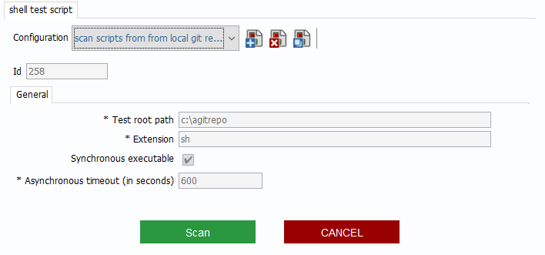
A configuration cannot be modified (because it could impact already existing and running campaigns)
If you don’t have any existing configuration, just add one by clicking on
If you have an existing configuration but need to adapt it (e.g. your scripts are in a different location on your server), just add one by clicking on
Here, we created a configuration that allows scanning from my local PC , in a local git repo that is ‘c:\agitrepo’

Slide 7
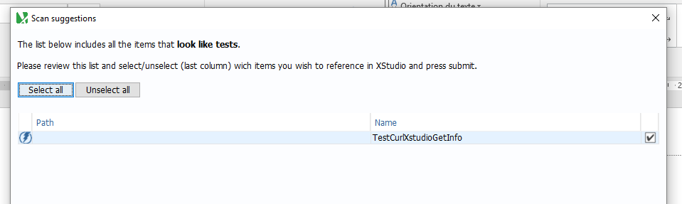
After submitting, XStudio will access the repository you specified and search all scripts with the extension you specified (here ‘.sh’) and load them into your category
Here, XStudio found only one in the local git repo.
select it and it loads into my XStudio DB

Slide 8
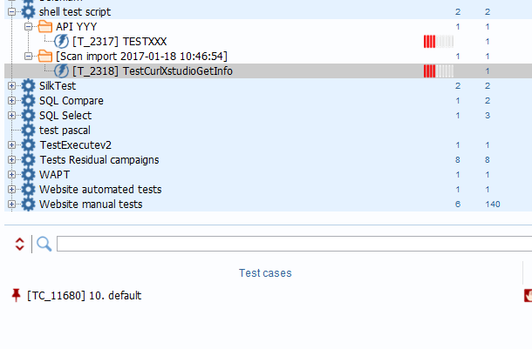
The .sh script is now referenced in my XStudio
And a default test case has been created for it

Slide 9
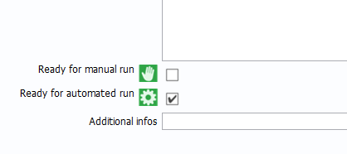
Manual or Automated test case ?
A test case can support both
To be executable as “automated” you need to ensure the test case is flagged for it
Here the test case can run in Automated mode
Here the test case cannot run in manual mode

Slide 10


XStudio
DB
Testxxx
You can directly run your test - we call it “On-the-Spot” execution
Click on the test and the right pane will show the buttons
This allows
Testing you test script as you build it
Testing a working script with various configuration
Running a single test to verify
Note that you can also run it with another Launcher . This is useful when:
  your test supports both Manual and Automated
  You are improving/adapting/creating a launcher

Slide 11
XStudio
DB
Playground
Campaign
Testxxx
With the on-the-spot run the execution will happen in the “Playground” campaign folder
This is a special folder that contains all On-the-Spot run
You need to clean it from time to time – delete old campaign /sessions that served to verify your test

Slide 12
But before you execute the test you need to provide some information
Mandatory ones:
  Which SUT are your testing against ?
  Which configuration are you using ?
  How do we need to react in case of dependent test failing or not executed ?
Optional
  Who must be executing the test ? (this is for manual tests)
  On which Agent (server/PC) is the test going to run ?
  Who needs to be notified through email that event happened on that session ?

Slide 13
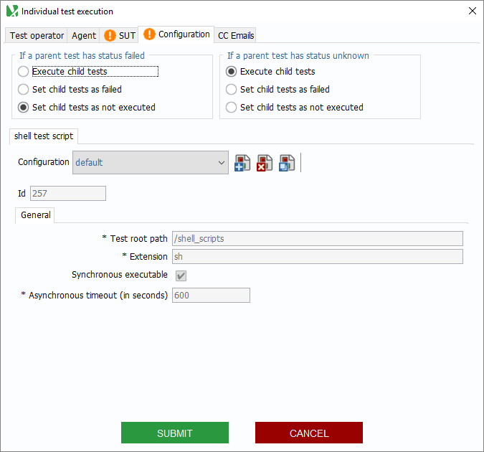
Let’s focus on the configuration and behavior
Behavior
Configuration

Slide 14
Behavior
Imagine dependency graph as follows
Test A
Test B
Test C
Test D
Test E

Slide 15
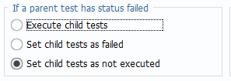
Behavior
Imagine dependency graph as follows
Test A
Test B
Test C
Test C is ‘not executed’
Test D
Test D is ‘not executed’
Test E
Test E is ‘not executed’

Slide 16
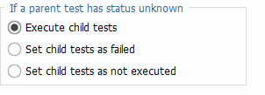
Behavior
Imagine dependency graph as follows
Test A
Test B
Test C
Test C is ‘executed and fail’
Test D
Test D and E are ‘not executed’
Test E

Slide 17
Configuration
This is the setup that the agent (the server or PC where the test will be run) will provide to the Launcher
DB
Executing on distant test harness machine
Executing on user PC
Xagent (“Harness1”)
XStudio
Configuration
“local PC”
Configuration
“Harness test servers ”
Laucher shell.jar
Laucher shell.jar
/home/tests/shell_scripts/testXXX.sh
/testHarness/shell_scripts/testXXX.sh

Slide 18
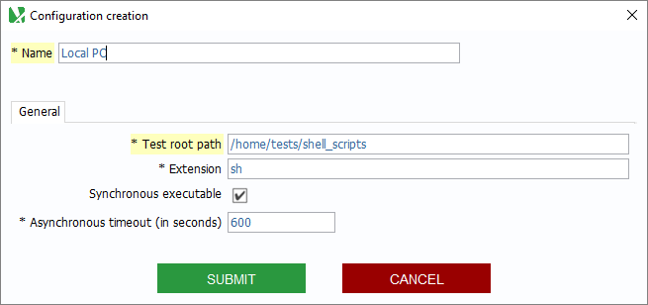
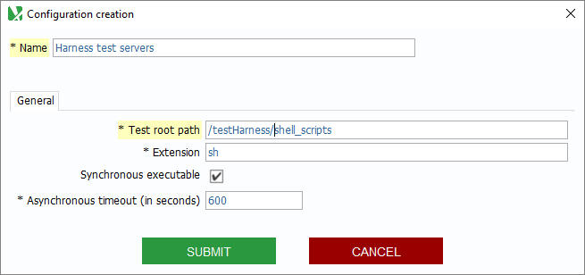
Configuration
“local PC”
Configuration
“Harness test servers ”

Slide 19
We have several configurations that can be used for these test
Scan scripts from local git repo
Local PC
Harness test server
You select the configuration you want when you execute a test session
  This allows to run test sessions on different agents (local, remote) with diverse setup

Slide 20

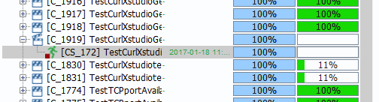
Once you submit the test will execute On-the-Spot
And you will get the results in the session that has been automatically created in the Playground folder for you
The session includes the test we ran on-the-spot
The result (quality) is 0% - because it was either “not executed” , or it “failed”

Slide 21
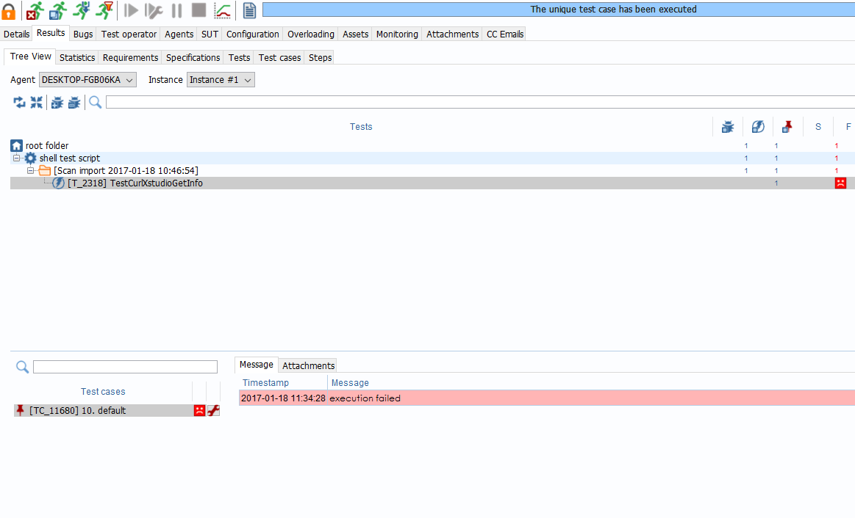
Click on the “results” tab
Click on “tree view” sub tab
And you see the status of all of your tests – only one you run when on-the-spot
And then the detail for each test case
This is what we expected as our test script was not doing anything …

Slide 22
Here is a sample shell script for that test
Using Curl, it tests a simple REST API (getinfo) that return basic JSON information if the server is up and running or an HTML body with error 404 otherwise

Slide 23
#!/bin/bash
echo hello
# turn off echo
set +v
# list all arguments
echo "$@" >./log.txt
#initialize variables
ipadress="127.0.0.1"
port="8080"
expectedresult="Success"
# initialize the options with their values
while [ "$#" -gt 0 ]; do
case "$1" in
-ipadress) ipadress="$2"; shift 2;;
-port) port="$2"; shift 2;;
-expectedresult) expectedresult="$2"; shift 2;;
--ipadress=*) ipadress="${1#*=}"; shift 1;;
--port=*) port="${1#*=}"; shift 1;;
--expectedresult=*) expectedresult="${1#*=}"; shift 1;;
-*) echo "unhandled option: $1" >&2 ; shift 1;;
--*) echo "unhandled option: $1" >&2 ; shift 1;;
*) args+="$1"; shift 1;;
esac
done
# Enumerating arguments but we don't use them in that script
for arg
do
echo $arg >>./log.txt
done
That part gets input parameters
This is a sample and should not be taken as the right practice for such a script.
Note: Xqual does not provide nor support test scripts

Slide 24
# To get the value of a single parameter, just remember to include the `-`
echo The value of ipadress is: $ipadress >>./log.txt
echo The value of port is: $port >>./log.txt
echo The value of expectedresult is: $expectedresult >>./log.txt
curl http://$ipadress:$port/xstudio/api?command=getInfo >./curlresult.txt
curlError=$?
echo >>./log.txt
echo Curl returned error $curlError >>./log.txt
# assertion if string is found the server asnwers something good to te request
grep "application_title" curlresult.txt >/dev/null
grepError=$?
echo >>./log.txt
echo gred returned error $grepError >>./log.txt
cat ./curlresult.txt >>./log.txt
rm ./curlresult.txt
That part run the curl command and assert results
This is a sample and should not be taken as the right practice for such a script …
Note: Xqual does not provide nor support test scripts
xstudio may have to be replaced by the name of the your server e;g; ‘xqual’, ‘cannes’ etc .

Slide 25
# see if you got a success
errorcode=0
if [ $grepError -eq 0 ] && [ $curlError -eq 0 ]
then
echo "[Success] Server answered" >> ./log.txt
# if we expected a failure then this not good
if [ "$expectedresult" = "Failure" ]
then
echo "[Failure] we expected a $expectedresult" >>./log.txt
errorcode=1
# otherwise this is as expected
elif [ "$expectedresult" = "Success" ]
then
echo "[Success] we expected a $expectedresult" >>./log.txt
errorcode=0
fi
# you got a failure ...
else
echo "[Failure] Didn't get answer back" >>./log.txt
if [ "$expectedresult" = "Failure" ]
then
echo "[Success] we expected a $expectedresult" >>./log.txt
errorcode=0
elif [ "$expectedresult" = "Success" ]
then
echo "[Failure] we expected a $expectedresult" >>./log.txt
errorcode=2
fi
fi
# handle errorcode
exit $errorcode
That part analyses return and exit accordingly
This is a sample and should not be taken as the right practice for such a script …
Note: Xqual does not provide nor support test scripts

Slide 26
Note that:
The script fills the “log.txt “file
This file will be parsed and analyzed by the “shell.jar” Launcher
To know how the launcher runs the script and how it gets results back, you need to see the documentation of the launcher you use
Here : http://www.xqual.com/documentation/launchers/shell.html
Every Launcher act differently

Slide 27
A test that has been verified through on-the-spot execution can then be included into any campaign
XStudio
DB
Campaign
“functional test on API yyy”
Testxxx
You include this Testxxx as part of a campaign

Slide 28
In the campaign tree , choose the folder in which you want to locate the campaign
Then create a campaign
To define the content (which tests are part of the campaign) you can:
Select the tests one by one
Select test based on a filter
  Select all test that are linked to a SUT
  … or link linked to a set of Requirements
  … or linked to a set of spec…
This is not the purpose of this presentation

Slide 29
Then for a campaign,
you create a session and, as for the on-the-spot Run, you need to provide :
The configuration
The SUT against which the session will run
The agents that can execute that session

Slide 30
Summary: We reviewed
How to link a test to launcher ( in this case a shell launcher)
How to scan existing test
How to create multiple configuration
A sample of shell script (bash .sh)
We recommend you to:
  Create your own shell
  Scan and import them into you DB
  Run them on the spot

Slide 31
End of presentation

