Slide 1
Create a test that call Rest API
Define it in Xstudio
Define needed parameters
Run it with a simple configuration
Review results
Use parameters to generate test cases

Slide 2
Test machine (Agent)
XSTUDIO
DB
Collect log information
System Under Test
Log file
Call Rest API and get results
System Under Test
(XSTUDion3.1 REST API)
Launcher
BAT_with_Params_vcs
BAT Sript
Curl getinfo
Provides Full environment
data
Provides chosen parameters
192.168.10.100

Slide 3
Test machine (Agent)
XSTUDIO
DB
Get all messages and log file
System Under Test
Get results
System Under Test
(XSTUDion3.1 REST API)
Log file
Launcher
BAT_with_Params_vcs
BAT Sript
Curl getinfo
192.168.10.100

Slide 4
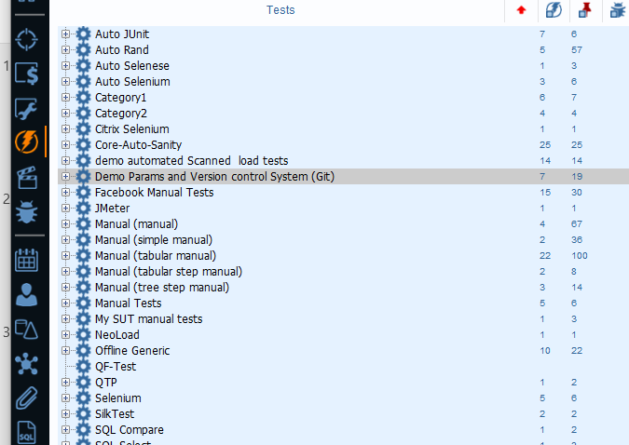
In the test tree
Create a ‘category’
Here we created
‘Demo Params and Version control System (Git)’

Slide 5
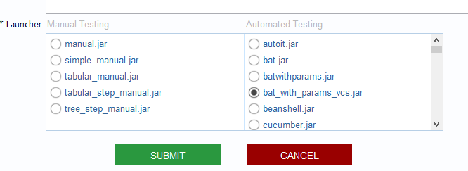
Associate the category to a Launcher
There are many launchers ( > 75 as of 3.0), out of the box
And you can easily create your own ones
Here we use a special launcher*
bat_with_params_vcs
*
This specific launcher allows running Windows batch scripts
We created it based on the standard “bat” launcher to demonstrate how one can adapt any launcher
you can get it from support@xqual.com

Slide 6
Under the category
Create at least one ‘folder’
Here we created
‘Common to all projects’
‘Project demo 1’
and ‘Project demo 2
Note about ‘Common to all projects’ folder
we recommend to create folders that contain tests that are common to multiple projects or that can serve as models
This favors reusability and capitalization , avoiding to get many time the same test redefined in multiple projects

Slide 7
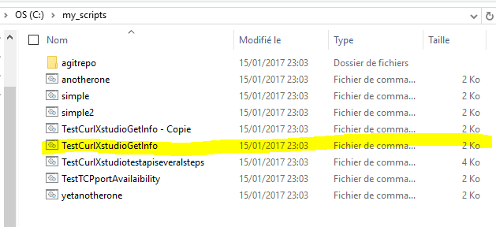
Add a test
The ‘test name’ MUST match the real physical ‘test script name’
Here we have ‘TestCurlXstudioGetInfo’
On the test agent we will need this script ‘TestCurlXstudioGetInfo.bat’

Slide 8
We’ll see, in the second part of this presentation, that
we can deploy the scripts on any agent (test machine) at run time
using a central repository (GIT, SubVersioN, or a SMB share)

Slide 9
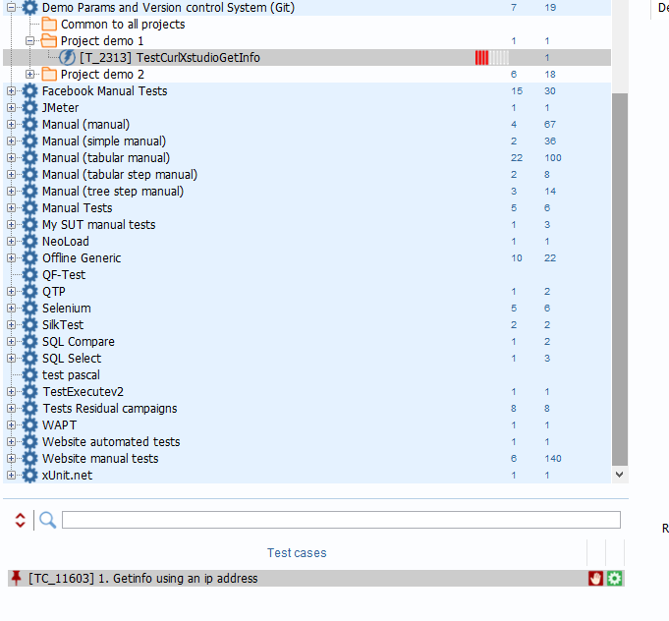
Add a test case
Use any name that is useful for you
Here we have ‘Getinfo using an IP address’
Always get some description to understand the goals and limitations of your test case

Slide 10
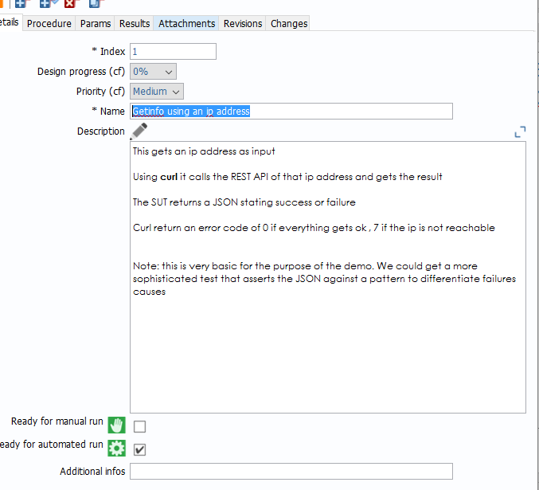
Declare your test case as « automated »
Note that a script can be manual and/or automated
Note: usually you start by having a manual test that you automate later

Slide 11
XSTudio can calculate the ratio of automated test cases vs manual ones
This is a KPI some agile projects and project for embedded systems set as part of their QA plan
e.g. The SUT should have 85 % of its tests that are automated

Slide 12
The index is used to order the test case
Any test case can have custom fields
You can have additional information – some launchers requires it
All of this information is provided to the launcher for each test case … and can be used by the test script

Slide 13
Summary: at this stage we have defined a test and a test case that maps a real scripted test
We need to define the parameters that the physical tests needs

Slide 14
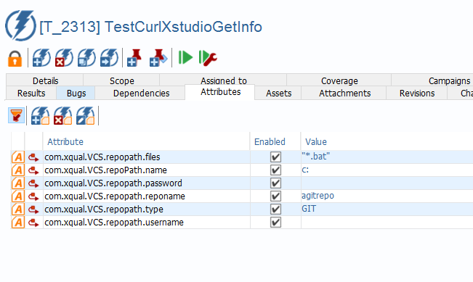
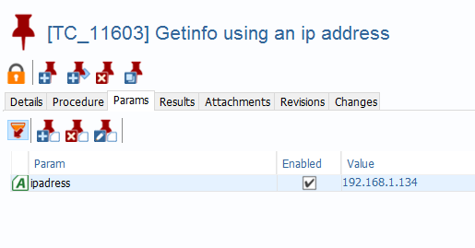
You can associate «Attributes » to test
You can associate « Params » to test case
Based on the launcher attributes and/or params can be passed to the script

Slide 15
In our demonstration
This launcher uses some “attributes” to prepare the test , but doesn’t provide it to each test case
We’ll see later that here we use some attributes to get the script for GIT repository
It passes the “Params” to each test case
Let’s focus on this for the moment

Slide 16
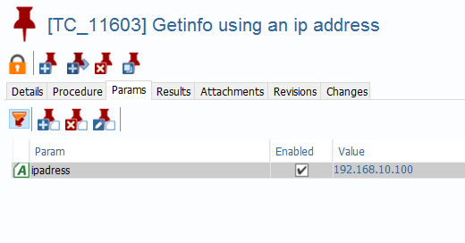
Create a « Param » that is the IP address that the script needs
Here we create « ipadress »
We ‘enable’ it
This means we will use it for this test case
And we value it

Slide 17
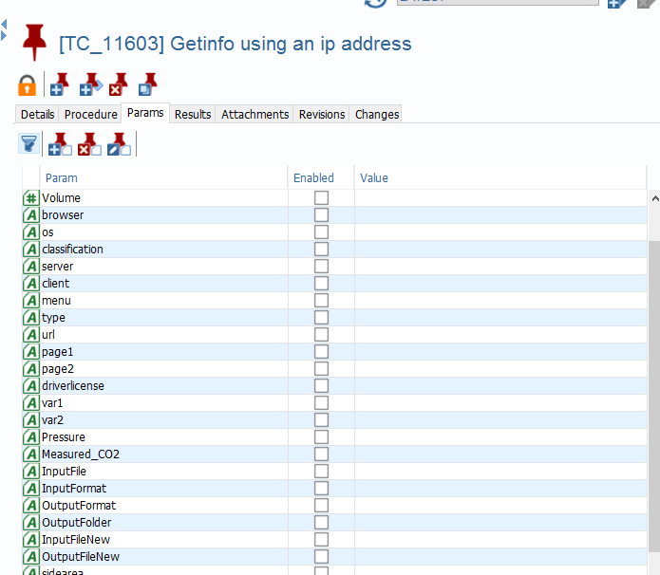
Note that as you go through, you will be creating multiple params
Before you create a new one, make sure you don’t have one defined already
This is done to maximize reusability between projects

Slide 18
Summary: at this stage we have declared a parameter that will be provided to the test script
We need to try our test

Slide 19
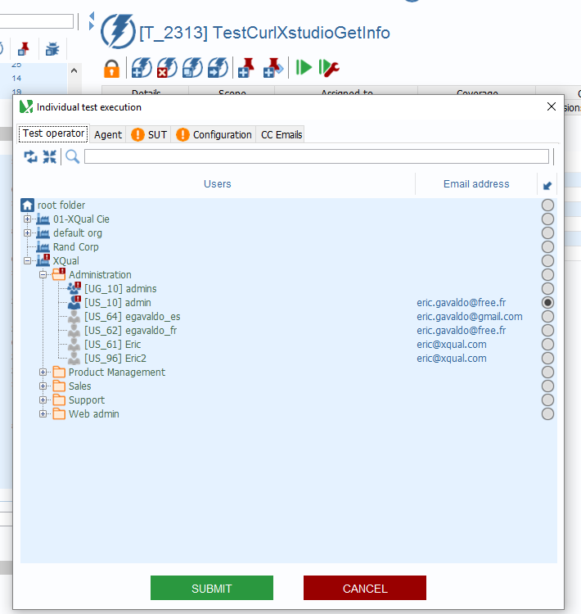
You can run your test on-the-spot
You don’t have to create a campaign for this
Click on the test and then “run”
You will be asked for different information

Slide 20
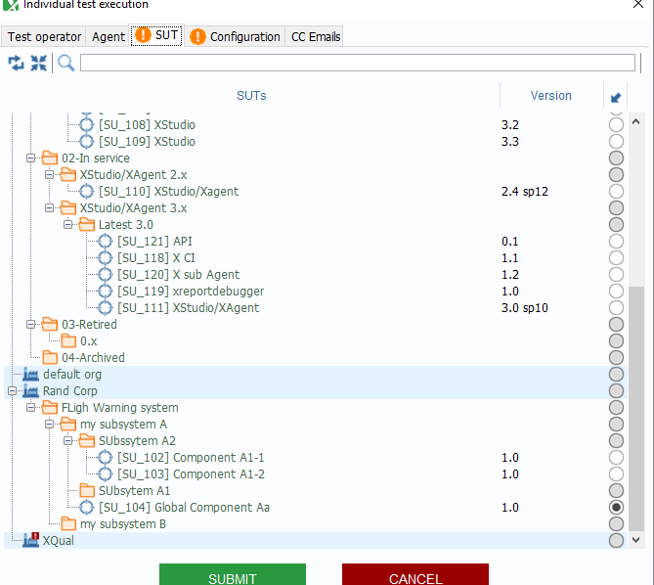
The tabs with an orange exclamation mark are mandatory
You must define against which SUT you will run your tests
At any time one test runs against one SUT

Slide 21
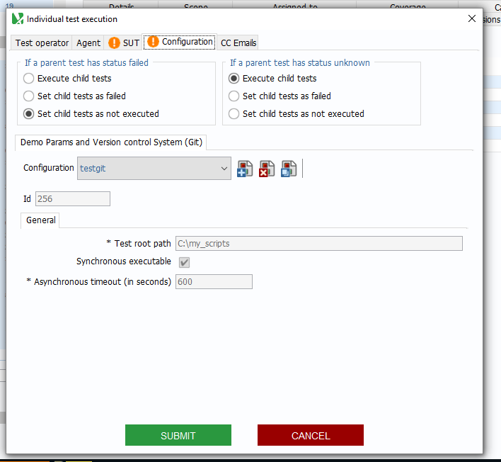
You set a configuration for the test
A « configuration » rely on the launcher your use
It defines the information needed to run all tests during a test session for one Launcher

Slide 22
Here we name the configuration « testgit »
This launcher needs 3 configuration info
The root path from which all tests will be run
If the script run in synchronous more or not
In case of ‘asynchronous’, how long do we wait before declaring the test as failed if we don’t get a result

Slide 23
Note: each launcher use a different configuration model
You can refer to : http://www.xqual.com/documentation/launchers/introduction.html
And get the detail for the launcher you use

Slide 24
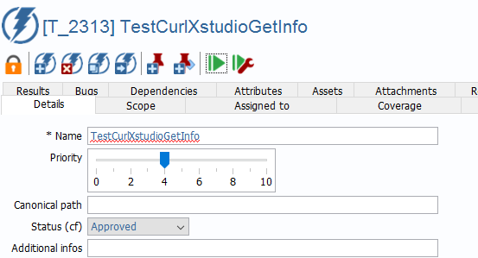
All tests for that session and that launcher will run from a root path
Here « c:\my_script »
So the launcher computes the path to the physical test script as follows:
Root path +
Canonical path +
test name
C:\my_scripts\TestCurlXstudioGetInfo

Slide 25
Note that you can also define on which test machine (agent) the tests will run
For manual tests, you can force a “test operator”
For any tests you can also set email destination
This way you are notified by email when some events of the test session occur

Slide 26
Summary: at this stage we are ready to run our test and to make sure we get the results we want
SUBMIT

Slide 27
In our demonstration
We are running the test on the local machine
We haven't yet started the SUT
We want to make sure the test fails and review the result
Let’s focus on this for the moment

Slide 28
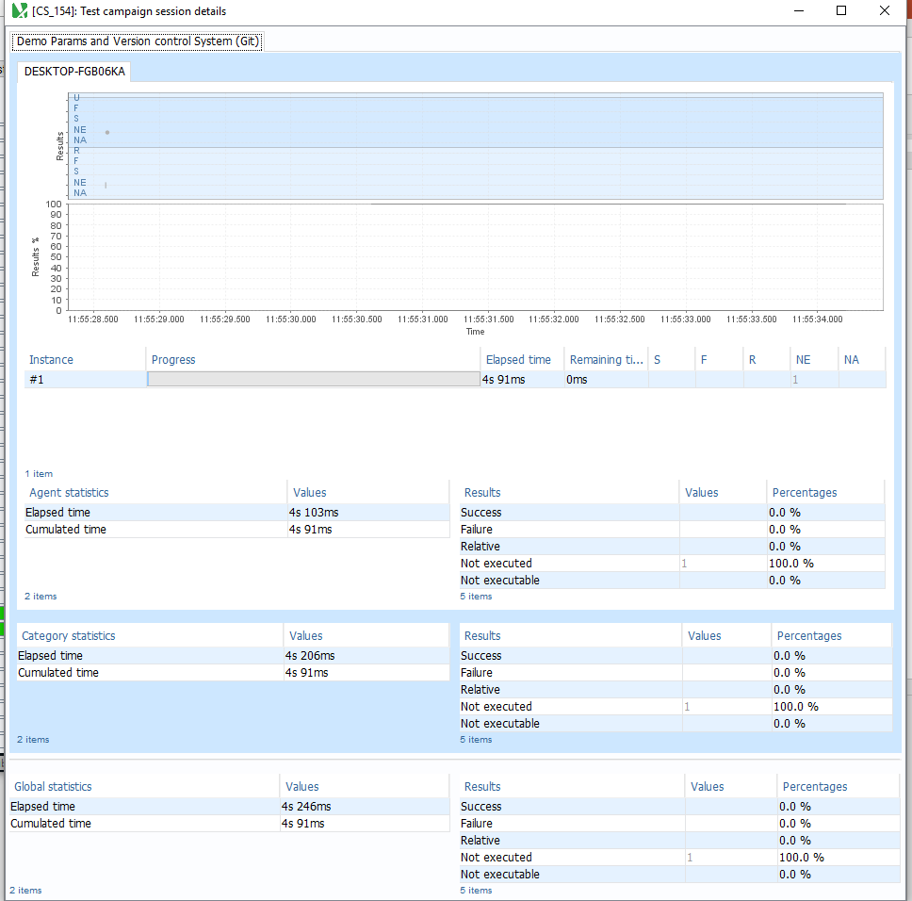
The test runs
On XStudio we can see a screen that provide information on the progress of the session

Slide 29
At end you are placed in a special Campaign folder : “playground”
This holds all of the on-the-spot tests’ runs
The campaign and session are created automatically for you
And you can review the results

Slide 30
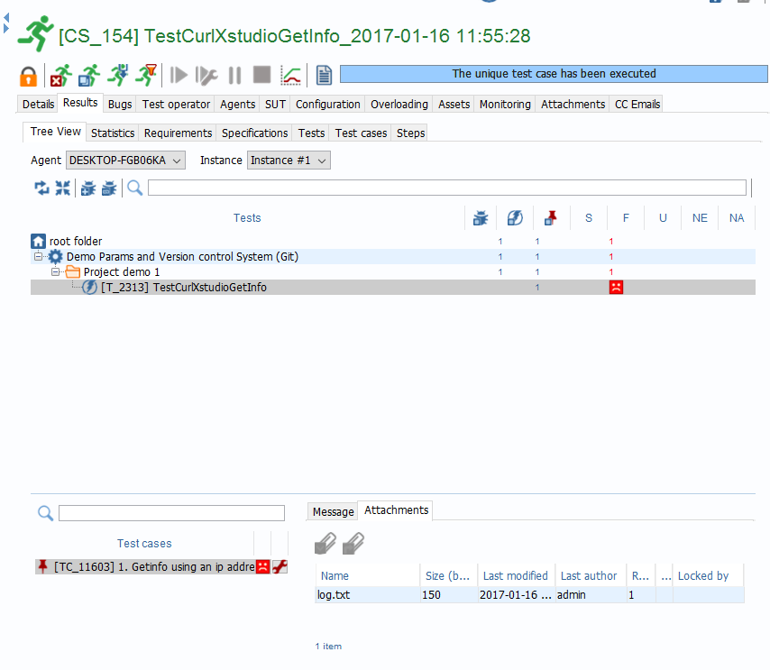
Click on the “results” tab
Click on the “tree view” tab
You see all tests that were run and their results (here we have only one)
Click on your test
It failed … which is what we wanted as the SUT is not started
Click on the test case (in the below pane)
It failed ! This is all as expected

Slide 31
Click on the message tab you will see messages
Here it says the test case failed
And we get a log.txt file that was parse and attached
Note: a test script can include any messages it needs by just logging them into the log.txt file and with the [Success] ,[Failure] or [Log] tag
Click on the attachment tab you will see the log.txt
Here its explained why we failed
The content of the log.txt is dependent on the test script itself
/debug /testcaseIndex=1 /ipadress=192.168.10.100
The value of /ipaddress is: 192.168.10.100
Curl retruned error 7
didn't get answer back

Slide 32
As an example:
The first part of the script gather any parameters that it wishes to uses
Here the ipadress (the params that we set in Xstudio) and a port (that one we didn’t set and don’t care)
It instantiates the parameters with their values
@echo off
echo %* > log.txt
@echo off
setlocal enableDelayedExpansion
set "options=/ipadress:"127.0.0.1" /port:"3306" "
for %%O in (%options%) do for /f "tokens=1,* delims=:" %%A in ("%%O") do set "%%A=%%~B"
:loop
if not "%~3"=="" (
set "test=!options:*%~3:=! "
if "!test!"=="!options! " (
echo Error: Invalid option %~3
) else if "!test:~0,1!"==" " (
set "%~3=1"
) else (
setlocal disableDelayedExpansion
set "val=%~4"
call :escapeVal
setlocal enableDelayedExpansion
for /f delims^=^ eol^= %%A in ("!val!") do endlocal&endlocal&set "%~3=%%A" !
shift /3
)
shift /3
goto :loop
)
goto :endArgs
:escapeVal
set "val=%val:^=^^%"
set "val=%val:!=^!%"
exit /b
:endArgs

Slide 33
As an example:
The second part run the Curl command line and log its results in the “log.txt”
This file will be parsed by the launcher
And then the script addresses the “success” or “failure”
set - >> log.txt
:: To get the value of a single parameter, just remember to include the `-`
echo The value of /ipaddress is: !/ipadress! >>log.txt
:Top
curl http://!/ipadress!:8080/xstudio/api?command=getInfo >>log.txt
echo. >>log.txt
echo Curl retruned error %errorlevel% >>log.txt
if %errorlevel% == 0 goto success
:failed
Echo didn't get answer back >> log.txt
Exit 1
Goto end
:success
Echo Server answered >> log.txt
Exit 0
:end

Slide 34
As an example:
Let’s add some tags into our “log.txt” so that we get messages
Let re-run our test using the same configuration
Now, once we run our test, we get a new message that states that the test case failed
if %errorlevel% == 0 goto success
:failed
Echo [Failure] Didn't get answer back >> log.txt
Exit 1
Goto end
:success
Echo [Success] Server answered >> log.txt
Exit 0
:end

Slide 35
Note that when we re-run our test, another campaign and session is automatically created into the “playground” campaign folder
Recommendation: from time to time, delete old playground campaigns

Slide 36
The ‘progress’ is 100% as all test cases have been tried
The Results (quality) is 0% as all test cases failed

Slide 37
Summary: at this stage we ran our test and get results including messages and log file
Let’s check that our test can also succeed !

Slide 38
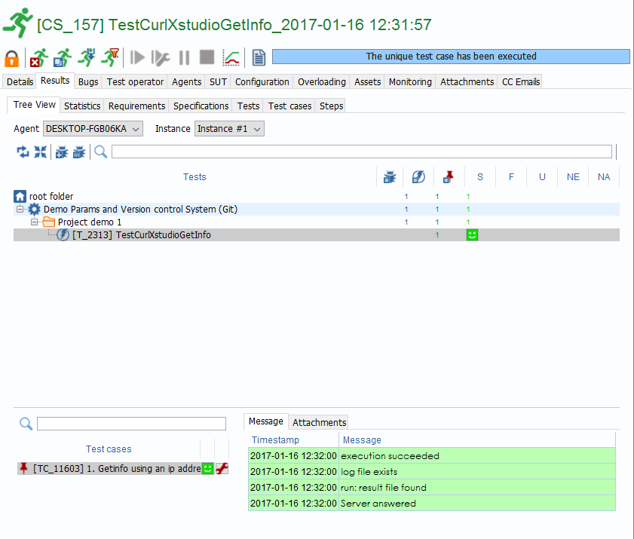
We start our SUT on a separate machine
Here, this is another XStudio instance, sitting on a different network (192.168.10.X)
We re-run the test and …
Test success, all messages are success and the log.txt is
/debug /testcaseIndex=1 /ipadress=192.168.10.100
The value of /ipaddress is: 192.168.10.100
{"application_title":"XStudio","application_copyright":"(c) copyright XQual","application_version":"3.1b0 build#WP-5256-205","database_schema_version":"79"}
Curl returned error 0
[Success] Server answered

Slide 39
Now imagine we want to test our SUT against other parameters and check that it succeed or failed
This sounds more like real life

Slide 40
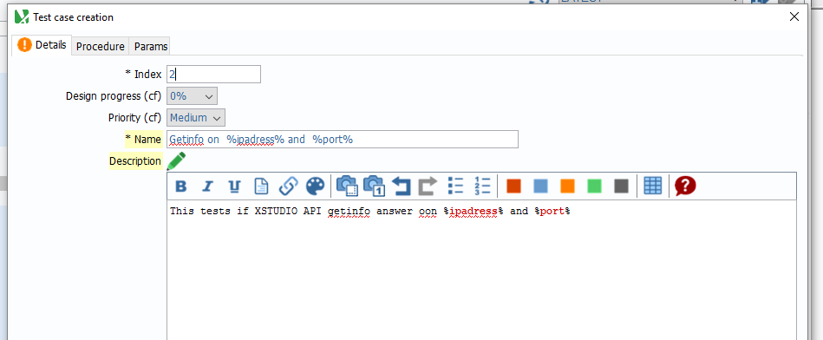
We create a new test case
The name will take ‘params ‘ as variables:
Getinfo on %ipadress% and %port%
With this special notation you XStudio will automatically replace the variables by their values
You can consider this test case as a pattern

Slide 41
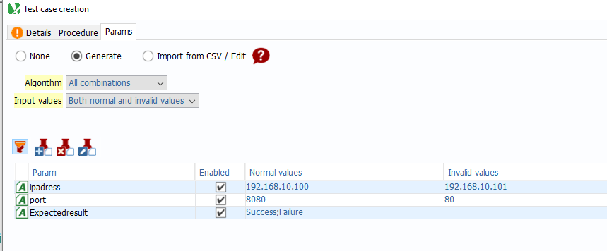
In the ‘params’ tab we declare that we use 3 parameters:
“Ipadress” (as before)
We define valid and invalid values
“Port” ( we had in our ‘params’ but di not associate it before)
We define valid and invalid values
“expectedresult”
It can be valued as “Success” or “Failure”

Slide 42
Expectedresult
It will used by our script to check if the result is the one we expected
When a test case uses one of the invalid value for ipadress or port, it must fail … and this is an expected result
In such case we value ‘expectedresult’ to “Failure”
The test case is successful if the curl command in the script fails

Slide 43
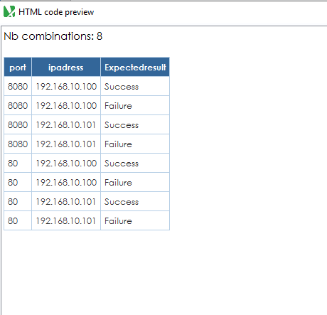
You can request XStudio to pre-calculate the multiple test case combinations using pairwise or complete algorithms
Here we just calculate all, providing 8 combinations

Slide 44
But some of the combinations are wrong :e.g. if we ‘getinfo on 192.168.10.100 and port 80, the expectedresult can’t be ‘success’ (the API answers on port 8080 , not on port 80)
So we eliminate those wrong combinations
Keeping us 4 combinations (plus the test we already had)

Slide 45
We need to adapt the script so that it allows to take into account those new parameters (port and exepectedresult)
And to get some logic to use expectedresult accordingly

Slide 46
Add the 2 params and set default values
Modify the curl command line to use the port parameter
Change the exit logic to state that we succeed and expected a failure then this failed (and the contrary)
set "options=/ipadress:"127.0.0.1" /port:"8080" /expectedresult:"Success" "
curl http://!/ipadress!:!/port!/xstudio/api?command=getInfo >>log.txt
if %findstrError% == 0 if %curlError% == 0 goto success
:failed
Echo [Failure] Didn't get answer back >> log.txt
If "!/expectedresult!" == "Failure" echo [Success] we expected a "!/expectedresult!" >>log.txt
If "!/expectedresult!" == "Success" echo [Failure] we expected a "!/expectedresult!" >>log.txt
If "!/expectedresult!" == "Success" Exit 1 >>log.txt
Exit 0
Goto end
:success
Echo [Success] Server answered >> log.txt
If "!/expectedresult!" == "Failure" echo [Failure] we expected a "!/expectedresult!" >>log.txt
If "!/expectedresult!" == "Success" echo [Success] we expected a "!/expectedresult!" >>log.txt
If "!/expectedresult!" == "Failure" Exit 1 >>log.txt
echo. >>log.txt
echo Exit 0 >>log.txt
Exit 0
:end

Slide 47
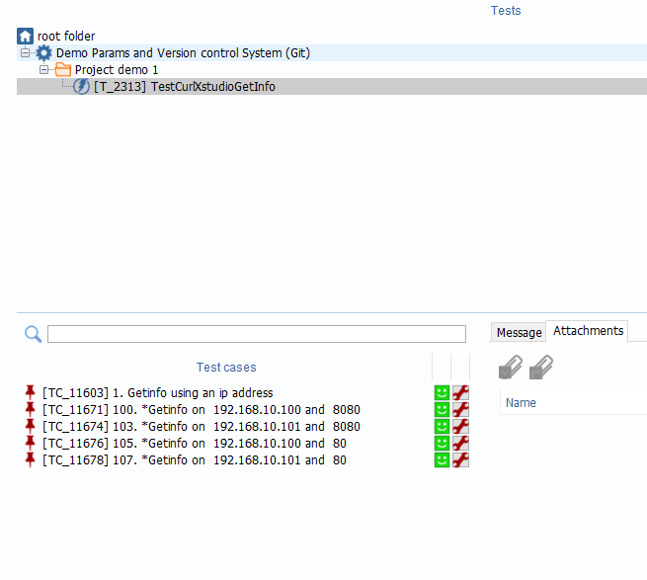
Re-run the test and it all come as success !

Slide 48
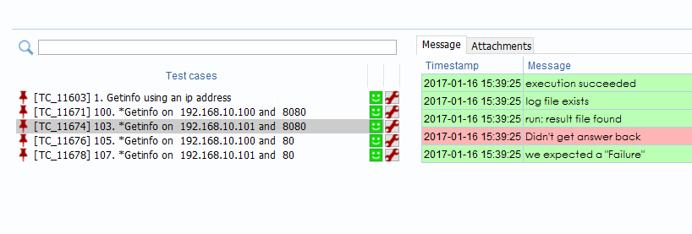
Getinfo must fail in test case 3, as the address “192,168,10,101” is not reachable
It does so, as stated in the message
But we expected it to fail (expectedresulkt = Failure) so the test case is a success
Our session has a progress= 100% and a result = 100%
Our test is Ready for prime time

Slide 49
Using “params” as input to scripts is common to all Launchers … for test framework that expect data as input
Check the documentation for the launcher you use: http://www.xqual.com/documentation/launchers/introduction.html

Slide 50
Using attributes
Updating your scripts from a Version Control system (e.g. GIT)

Slide 51
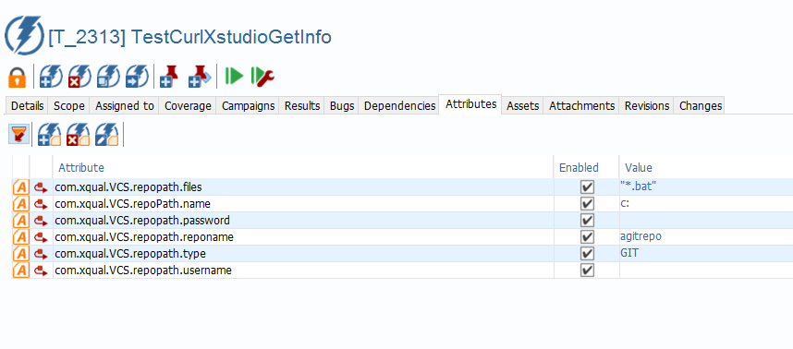
“Attributes” are defined and assigned to test (not to test case)
Here we use 6 attributes
There are defined and set in a similar fashion as for “Params” (used for test cases)

Slide 52
Here, we use these “attributes” to provide the launcher with enough information to:
Identify where is the origin GIT repository
Clone the repository on the target test machine (if it is not already)
Or update it, if it is already cloned
Place the required test files / test data in the target “Root path/test path/”
The work is done using a modifiable script that is called by the launcher before any test run

Slide 53
Using this …
We are always sure to use the latest scripts and data stored in a VCS (GIT in this example)
We can use a new test machine (agent) without having to first deploy all scripts. It will be populated at run time
Each customer can adapt the script to its specific security constraints and infrastructure

Slide 54
The “attributes” we use are all prefixed by ‘Com.xqual’
Then for the Version Control System we have a set of attributes .VCS”
Repopath.name is the repo root
here it is a local root “c:”
But it could ba standard git:\\
Repopath.reponame is the specific repository
here it is a repo named “agitrepo”
Repopath.files defines the files that are copy
here we wish to get all “*.bat” scripts files at once
Others attributes aren’t used in this demo

Slide 55
Our repo is “c:\agitrepo”
Our destination on the test machine (agent) is :
Root_path\test path\
Here it is “c:\My_scripts” as set in our configuration
The test path is empty

Slide 56
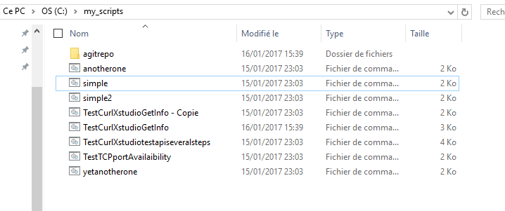
After we run the test, so we will find all *.bat in the c:\my_script folder on the test machine
And the cloned repo will be under this one

Slide 57
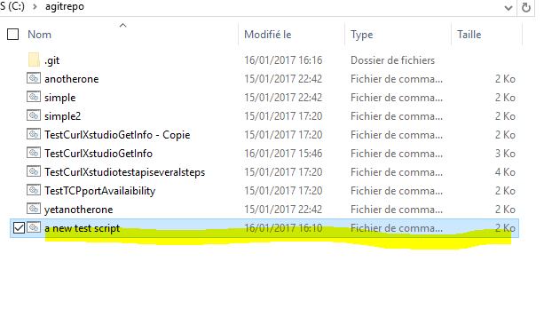
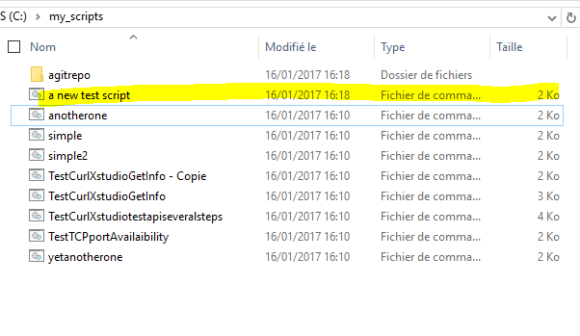
If we add a file in the c:\agitrepo (local GIT repository)
Let say we add “a new test script.bat”
Then git add “a new test script.bat”
then git commit –m”added a new script for demo”
Run our test, then the c:\my_script will get this new test script

Slide 58
Summary: by setting some attributes for one test, the launcher will execute a script that gather the needed files and place them to the destination on the target test machine (agent)
We recommend setting these attributes on a single test dedicated for that purpose, so that it can be reused

